Slide 1
INCLUDE Level of Detail
John F. Tripp

Slide 2
Exploring Calculations in Tableau
Level of Detail Expressions
  FIXED
  INCLUDE
  EXCLUDE

Slide 3
Level of Detail
Remember that we generally set our “level of detail” in two places
  Columns and Rows
  Detail Shelf

Slide 4
Level of Detail
The level of detail in the columns and rows + the detail shelf defines how the visualization will be rendered
We use level of detail expressions when we don’t want to use the other options - why?
  Because we want to create a calculation that is independent from the dimensions used to make the visualization

Slide 5
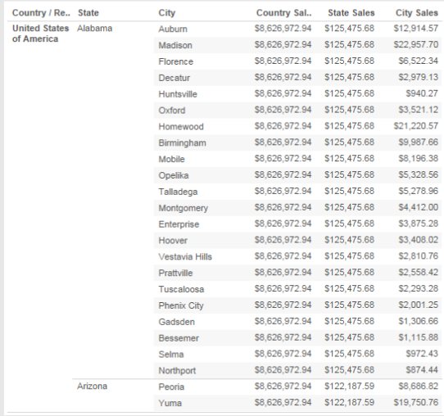
Level of Detail
Level of Detail expressions allow us to produce graphs with calculations at multiple levels at the same time
Could not do this with typical drag and drop functionality in Tableau

Slide 6
Include
Load the “Simple Sales Data” excel file

Slide 7
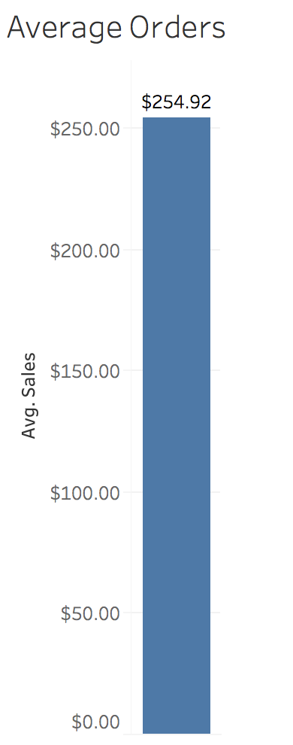
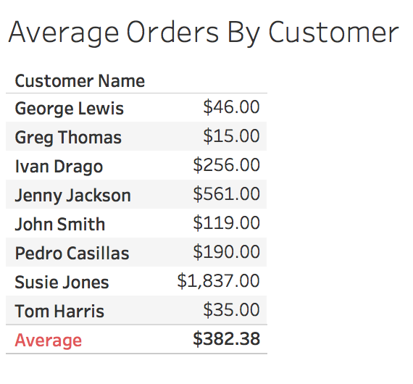
Include
Now create two sheets – average of all orders, and average of all orders by customer

Slide 8
Include
Now what if we wanted to compare the total average order ($254.92), with the average orders by customer?
  We can’t – because the LOD is different in the two examples
  This is what an INCLUDE LOD will allow us to do.

Slide 9
Include
Syntax
  {INCLUDE [dim1], [dim2]…, [dimN] : aggregate expression}
Include the LOD expression by using a calculated field.
  We should create a calculated field called LOD Sales Include Customer Name that looks like this:
  {INCLUDE [Customer Name]: Sum([Sales])}

Slide 10
Include
Now you should be able to make this:

Slide 11
Summary of Exclude and Include
The EXCLUDE and INCLUDE LODs are executed after data blending, and before measure filters are applied.
  These LODs are dependent upon the visualization in which they are applied.
    If you EXCLUDE a dimension that isn’t in the view, nothing will happen.
    If you INCLUDE a dimension into the wrong view, you’re going to get strange results.

